Slide 1
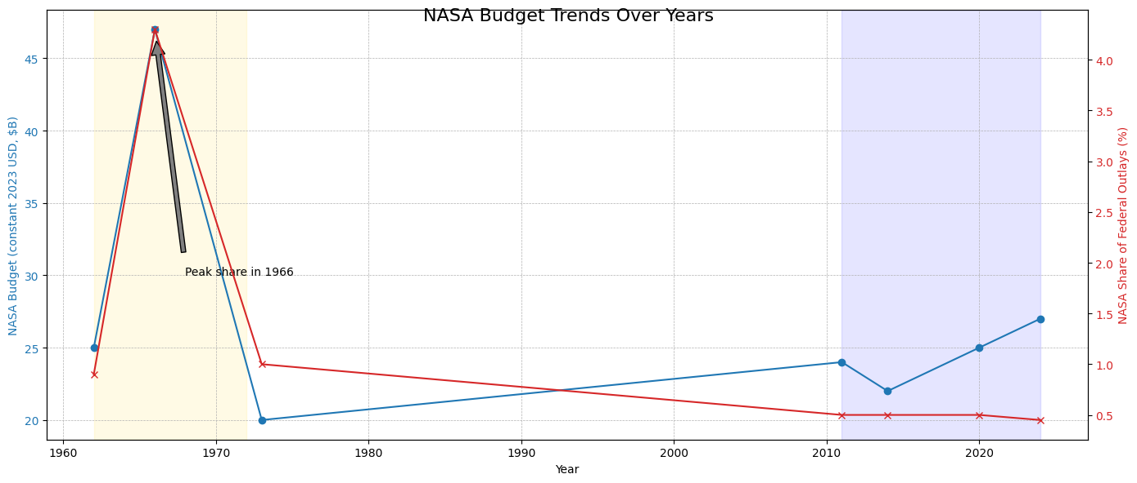
Budget Trends (Inflation-Adjusted)
Insights Apollo peak: NASA ≈4.3% of U.S. federal outlays (1966); constant-$ peak far above current levels. Artemis era: NASA ≈0.4–0.5% of federal outlays; Exploration accounts rising but below Apollo scale. Modern costs reflect safety, sustainability, and broader science/LEO programs.

